Slide 1

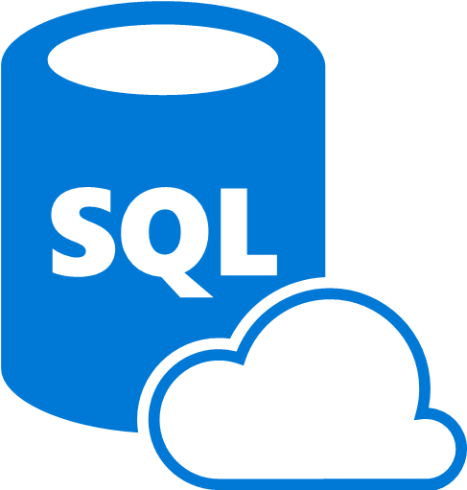

Azure DevOps para crear CI/CD pipelines con Azure SQL
Carlos López
Cloud Data Engineer
Microsoft MVP Data Platform

Slide 2

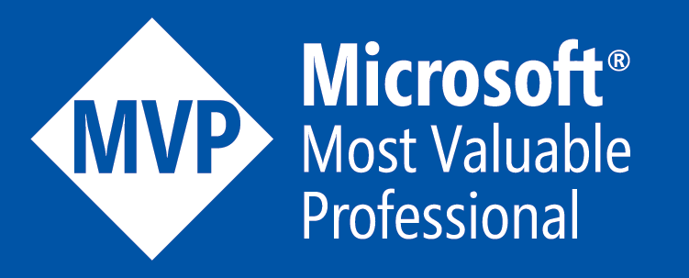


Carlos López
Cloud Data Engineer Microsoft MVP Data Platform
Community Work
Blogger, Speaker, Local Community Leader
carlos-lopez-taks
@CarlosLopezDBA
carlosarturo.lopeztaks

Slide 3


Agenda
Perspectiva de DevOps
Plan - Develop - Deliver - Operate
Fase Develop
Fase Deliver
Demo

Slide 4

El ciclo de vida de DevOps

Slide 5
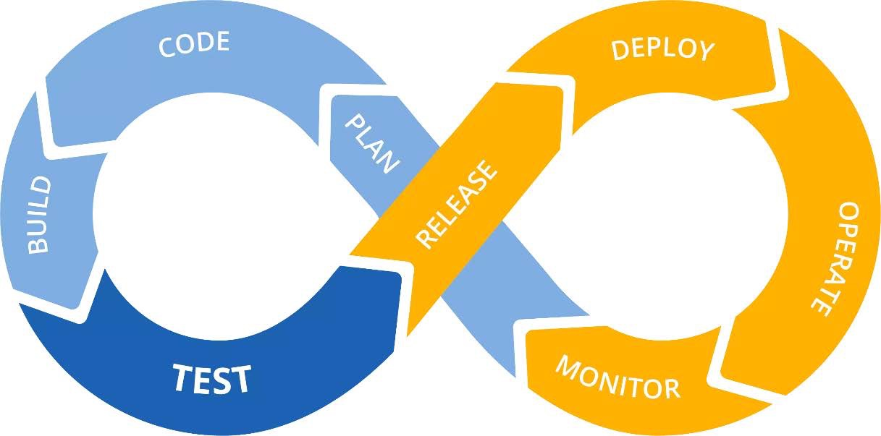
El Loop clásico
Notes:
When we see the classical loop for DevOps Cycle we think in CI/CD process right away as this is something we already have.
We take for granted the cultural impact required in the company
US - Categorization - Scrum poker estimation
-Story points - FIbonnacci
Pros / Cons
sprint planning, daily standup, sprint review, sprint retrospective and product backlog grooming
Backlog
Why is it important to mention it here? Because Azure DevOps has all the inherit process for using the cycle.

Slide 6
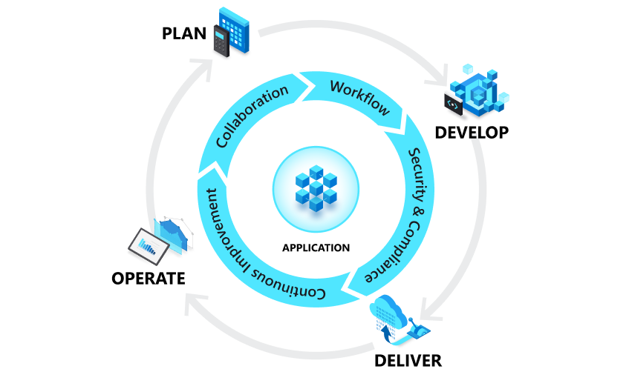
El ciclo de vida de Azure DevOps
Notes:
Azure DevOps provides a wide variety of services for DevOps teams so that they can plan, work,
collaborate on code development, and build and deploy software and services.
Most DevOps teams rely on several tools and build custom toolchains for each phase in the application life cycle.
When we look at the DevOps Clasical diagram we imagine a
Now we are analyzing the DevOps followed by the Microsft DevOps product,
In which we will focus on Develop en and Deliver Phases
In the following sections, we'll explain these phases and the corresponding Microsoft tooling and products in more detail.

Slide 7
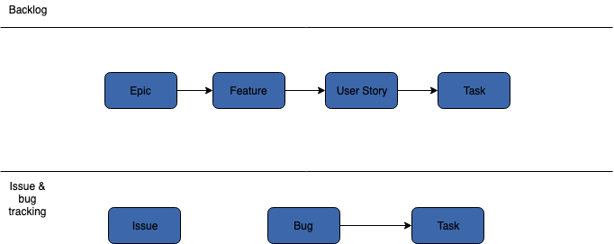
De Epicas a Historias de Usuario
Notes:
We’ve seen this structure based on SCRUM, in Azure DevOps the implementation of the process comes starting from backlog to
Azure Dev Ops allows us to manage the US to manage the tasks
Assign the workflow, managing the Backlog
US - Categorization - Scrum poker estimation
-Story points - FIbonnacci
Pros / Cons

Slide 8
Configurando Azure DevOps

Slide 9
Creando Agents en los Pipelines
Microsoft-hosted agents
Self-hosted agents
Notes:
To build and deploy your code using Azure Pipelines, you need at least one agent. An agent is a service that runs the jobs defined in your pipeline. The execution of these jobs can occur directly on the agent's host machine or in containers.

Slide 10
Especificaciones
Image | Classic Editor Agent Specification | YAML VM Image Label
Windows Server 2022 with Visual Studio 2022 | windows-2022 | windows-2022
Windows Server 2019 with Visual Studio 2019 | windows-2019 | windows-latest OR windows-2019
Windows Server 2016 with Visual Studio 2017 | vs2017-win2016 | vs2017-win2016
Ubuntu 20.04 | ubuntu-20.04 | ubuntu-latest OR ubuntu-20.04
Ubuntu 18.04 | ubuntu-18.04 | ubuntu-18.04
macOS 11 Big Sur | macOS-11 | macOS-11
macOS X Mojave 10.14 | macOS-10.14 | macOS-10.14
macOS X Catalina 10.15 | macOS-10.15 | macOS-latest OR macOS-10.15

Slide 11
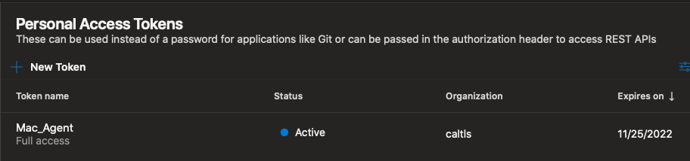
Self-Hosted Agents

Slide 12
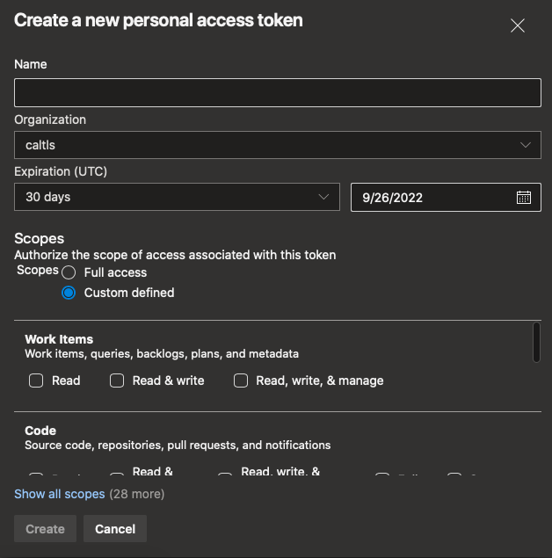
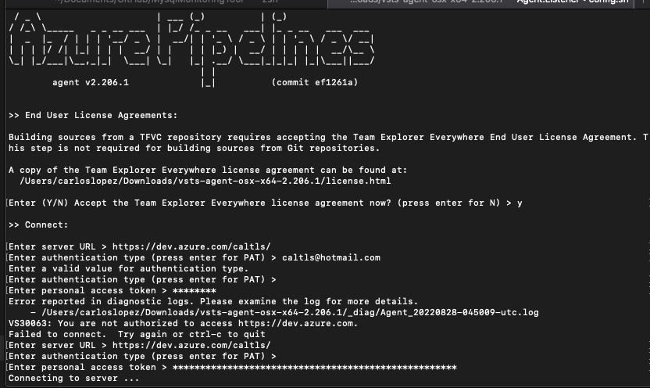
Self-Hosted Agents

Slide 13
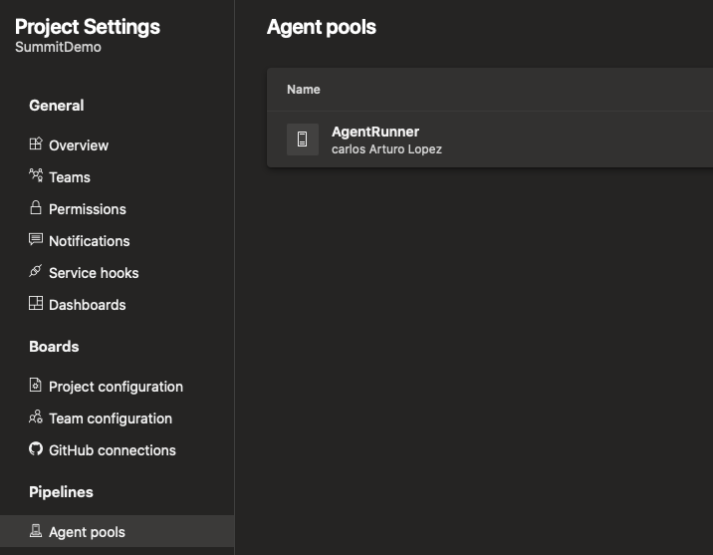
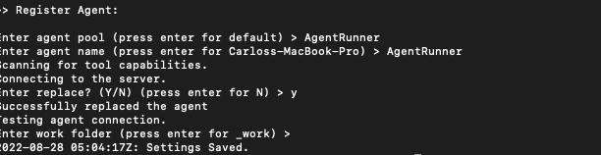
Self-Hosted Agents

Slide 14
Pipelines en Azure DevOps

Slide 15
Introducción a Azure Pipelines
Independientes de plataforma y del lenguaje native
Interoperabilidad entre diferentes tipos de repositorio
Coexistencia con extensions standard disponibles para construer Código
Compatibilidad para desplegar código con diferentes nubes de servicio.
Capacidad para manejar aplicaciones en contenedores.
Notes:
It's platform and language independent, which means you can build code on every platform using the code base you want.
It can be integrated with different types of repositories (Azure Repos, GitHub, GitHub Enterprise, BitBucket, and so on).
Lots of extensions (standard and community-driven) are available for building your code and for handling custom tasks.
Allows you to deploy your code to different cloud vendors.
You can work with containerized applications such as Docker, Azure Container Registry, or Kubernetes.

Slide 16
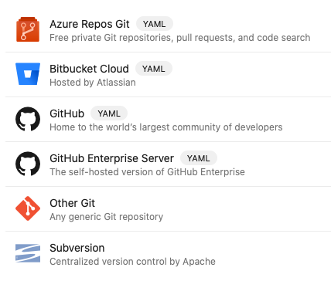
Desarrollo declarativo en Base de datos
Objetos Escalares
Listas y Colecciones
Diccionarios de Datos
Definiciones de Objetos DDL
Manipulacion DML (a nivel de operacion)
Notes:
When we build in DevOps we need to work in IaC model therefor we need a language capable to manage or handle the infrastructure.
So we need a declarative code to manage, and that is YAML.
So what can we do with it?

Slide 17
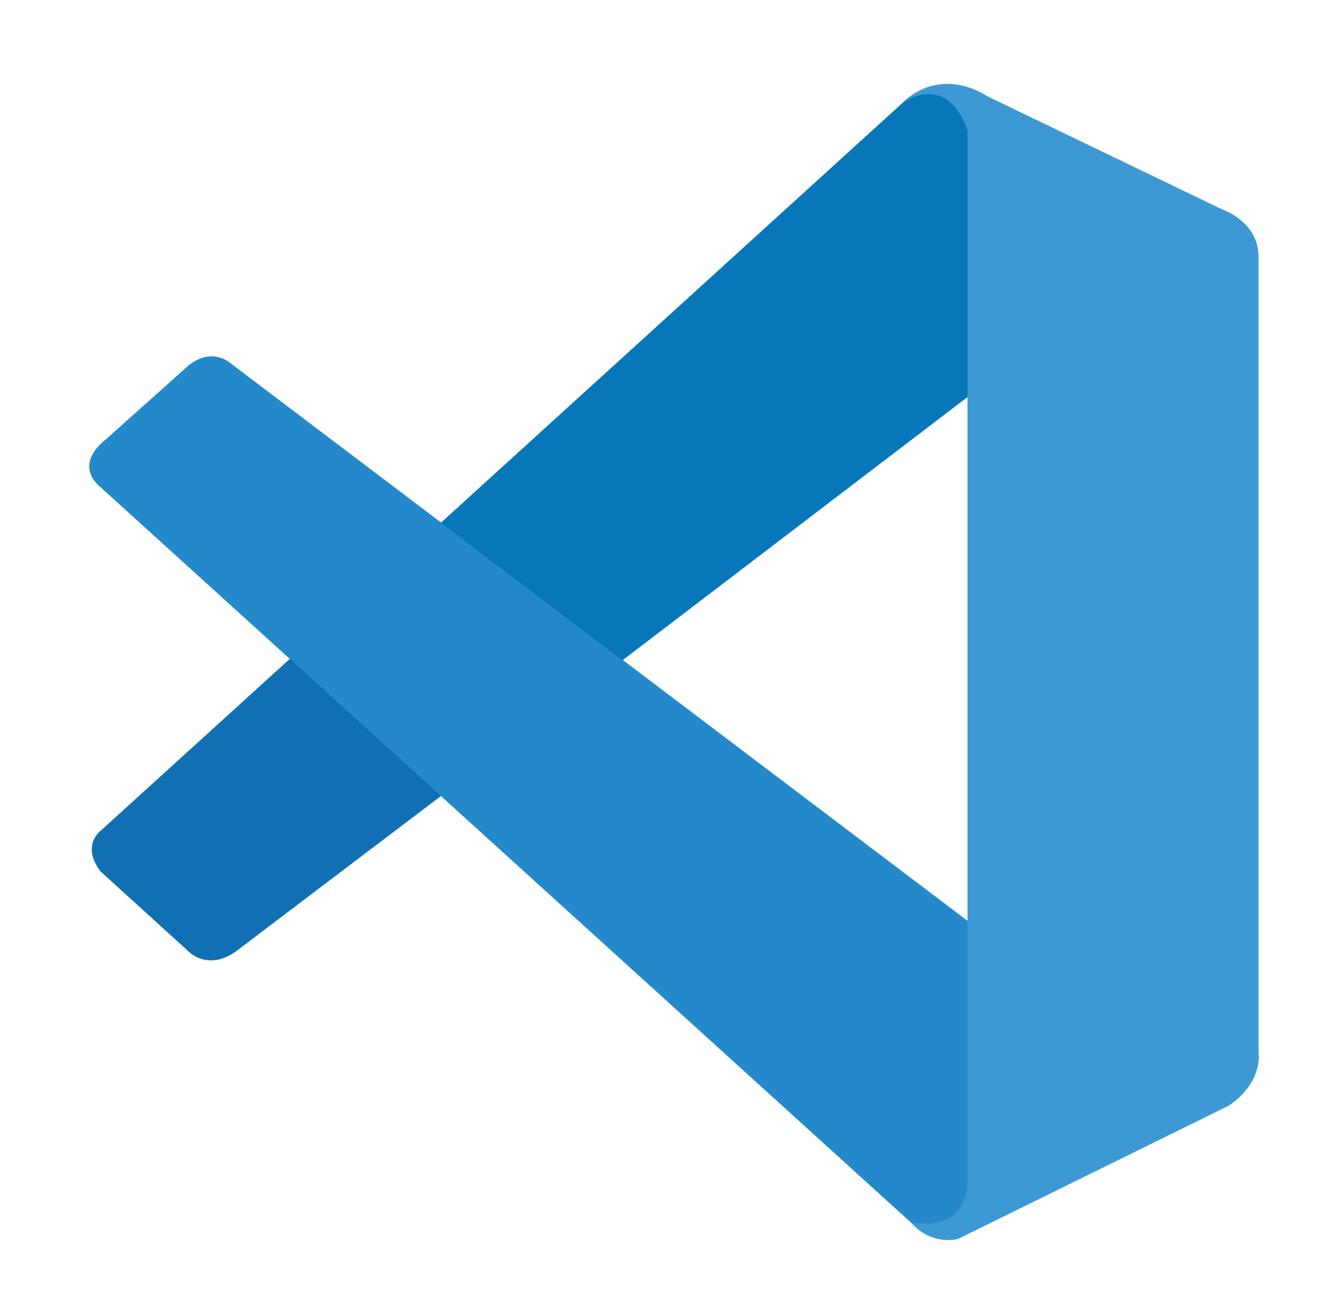


Las herramientas
Visual Studio Code SQL Projects in Visual Studio (SQLProj / SSDT)
Azure Data Studio Build SQLProj from command line (preview)
Alternate MSBuild SDK for SqlProj *

Slide 18
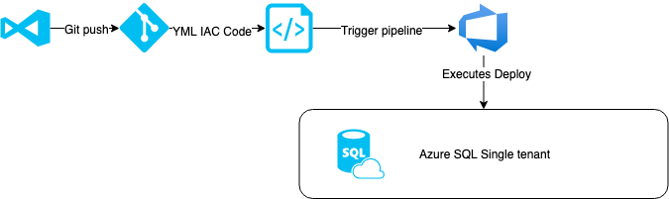
Escenario de despliegue
Azure Data Studio Cross-Platform SQL Projects

Slide 19
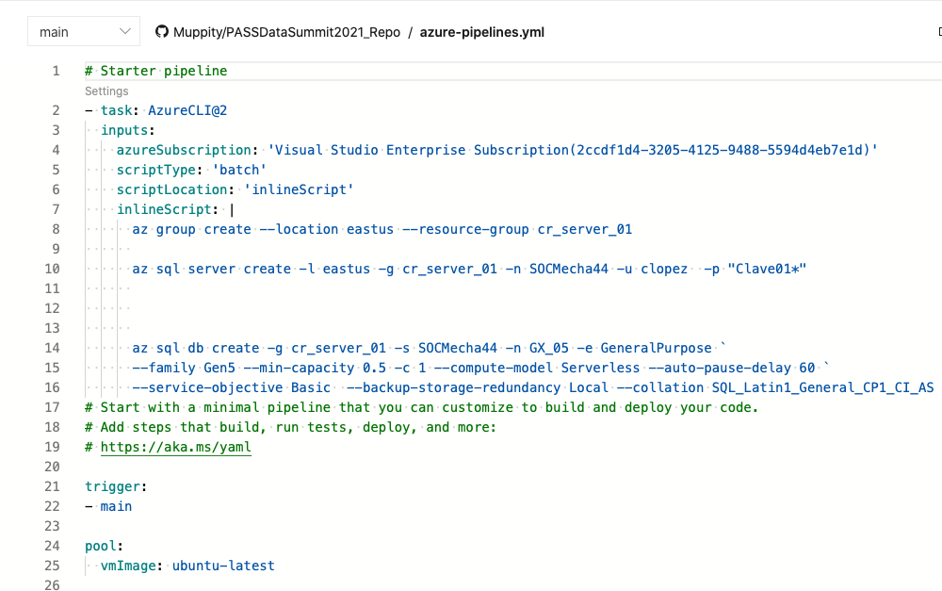
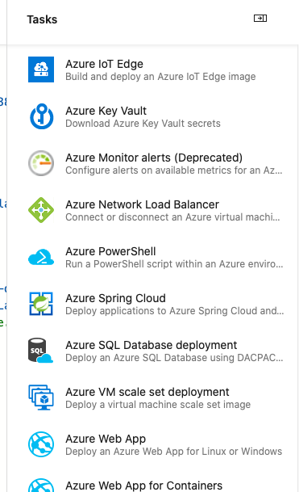
Una vista a la estructura YAML

Slide 20
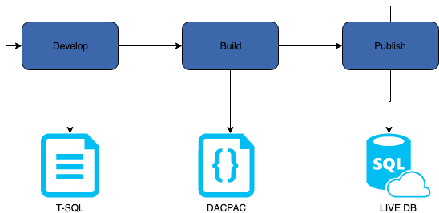
Configure Azure DB into pipeline

Slide 21
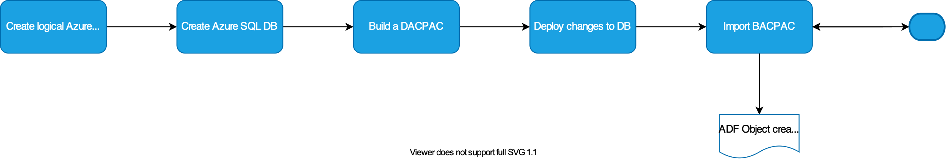
Pipeline Task Workflow
Example: Followed tasks to complete in the pipeline

Slide 22
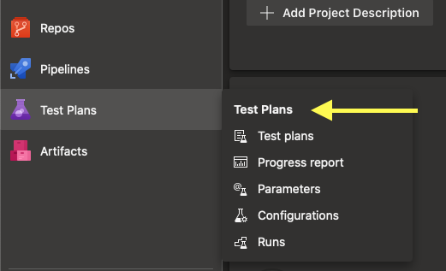
Toolset to build Quality Test
Code Analysis
SSDT Static Code Analysis examples
Samples in DACExtensions SqlServer.Rules
Standalone OSS
Sqlcheck
Code Testing
SSDT unit tests DBUnit tSQLt
SQL Code Guard

Slide 23
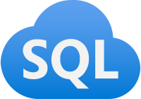
Pipeline demo Azure DevOps

Slide 24
Material Adicional
Docs Azure DevOps Azure SQL
Azure Pipelines agents Azure SQL documentation
YAML schema reference Azure SQL front page
Agent pools
Azure Devops, build GitHub repository
Blogs Learning
CI/CD for Azure SQL DB – Davide Mauri Azure SQL Ms Docs Learning Path
Code Sample Azure SQL Workshop
https://github.com/Muppity/PASSDataSummit2021_Repo

Slide 25


Slide 26




Carlos Lopez
.
Github
https://github.com/Muppity/Presentations-Material
Social Networks
/carlos-lopez-taks
@CarlosLopezDBA

